Slide 1
Introduction: LCAP Fundamentals
2024-2027 Three-Year LCAP Development
LCAP | Educational Partner Engagement | November 28, 2023

Slide 2
Welcome
Welcome / Opening
Superintendent Dr. Michelle Rodriguez
English: https://www.stocktonusd.net/cms/lib/CA01902791/Centricity/Domain/142/SUSD%20State%20of%20the%20District%202023%20-%20English.pdf
Spanish:
https://www.stocktonusd.net/cms/lib/CA01902791/Centricity/Domain/142/SUSD%20State%20of%20the%20District%202023%20-%20Spanish.pdf
https://www.stocktonusd.net/Page/17757

Slide 3
AGENDA
Introduction: LCAP Fundamentals
Topics:
LCAP Engagement In 2023-2024
LCAP and SUSD Guiding Principles
LCAP Requirements and Components
- LCAP Development, LCAP Lifecycle, LCAP Requirements, Educational Partners, LCAP Approval Process, Local Control Funding Formula
LCAP and School Plan for Student Achievement (SPSA) Alignment
Next LCAP Engagement Session

Slide 4
LCAP Engagement in 2023-2024
11/28: Introduction: LCAP Fundamentals
12/04: Current District Priorities – 2023-2024 School Year
01/19: LCAP Mid-Year Update and Funding
02/09: Data Analysis / District Areas of Need
02/19: Budget Projections
03/05: Survey Results and Key Findings
03/08: Identified District Goals/Activities
* April 2024: Post Draft 2024-2027 LCAP
* May 2024: Public Hearing 2024-2027 LCAP
* June 2024: Board Adoption 2024-2027 LCAP

Slide 5
LCAP and SUSD Guiding principles
IMPROVING
STUDENT
OUTCOMES

Slide 6
What is the LCAP?
Where Do I Find the LCAP?
SUSDs LCAP is available on the district’s webpage: https://www.stocktonusd.net/Page/16289
This webpage also provides a central location for updates on current LCAP activities and previous.

Slide 7
LCAP Guiding Principles
Transparency in SUSD
Inclusive communication and information to support decisions.
Equity in SUSD
Supporting students not on what is fair or equal, but equitable.
Subsidiarity in SUSD
Lowest level of decision-making, which is based on data and identified needs with input from educational partners.

Slide 8
JOY, TRUST, and Belief: Pillars of Success for SUSD
1 interaction
1 decision
1 day at a time
https://youtu.be/XKgMskwgHog?si=oyddC_MLMpyR2w29

Slide 9
Think time
Question 1:
What does it mean to have “Joy, Trust, and Belief” in the system that parents and families entrust their children to receive the best education possible?
2 minutes to Post your comment(s) in the chat box.
Questions 2:
What does “Joy, Trust, and Belief” look like in action?
2 minutes to Post your comment(s) in the chat box.

Slide 10
LCAP Requirements and components

Slide 11
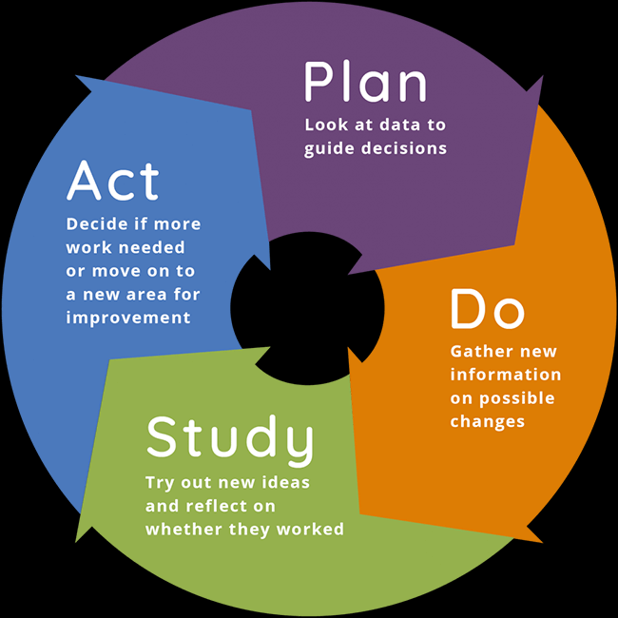
LCAP development
LCAP Development is ON-GOING and CYCLICAL.
Also referred to as the Continuous Improvement Cycle or Plan, Do, Study, Act (PDSA).
LCAP Development Involves 3 Functions:
Comprehensive Strategic Planning
(California Education Code [EC] Section 52064[e][1])
Meaningful Engagement with Educational Partners
(EC 52064[e][1])
Accountability and Compliance
(EC 52064[b][4-6])
(EC 52064[b][1] & [2])
(EC 52064[b][7])

Slide 12
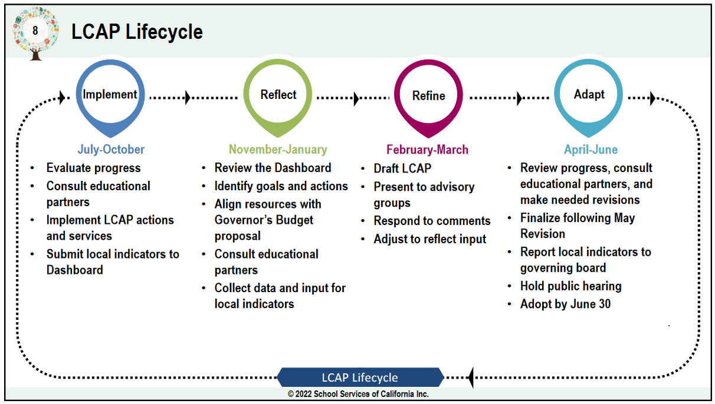
LCAP Lifecycle
1st Quarter +
(Jul 1 – Nov 30)
Active Implementation of LCAP Actions & Services
Networking with SJCOE on LCAP updates & timeline
Presented LCAP Engagement Plan at PACs
Working with Research to Release Survey

Slide 13
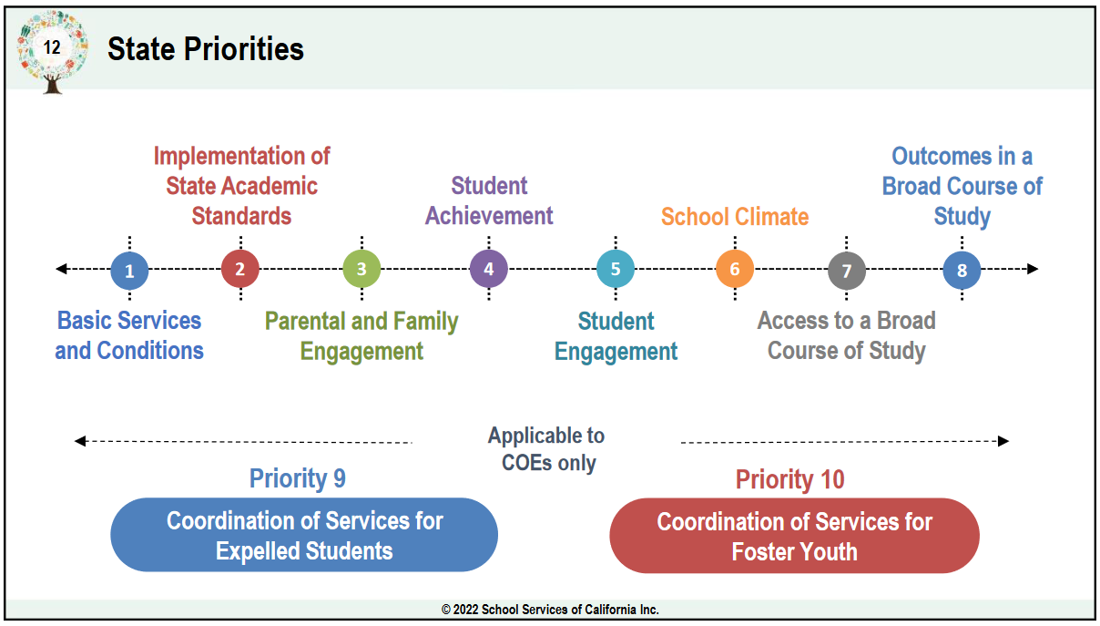
Inclusion of State priorities
Goals 1, 2, 3
Goal 1 – 2, 4, 7, 8
Goal 2 – 1, 6
Goal 3 – 3, 5

Slide 14
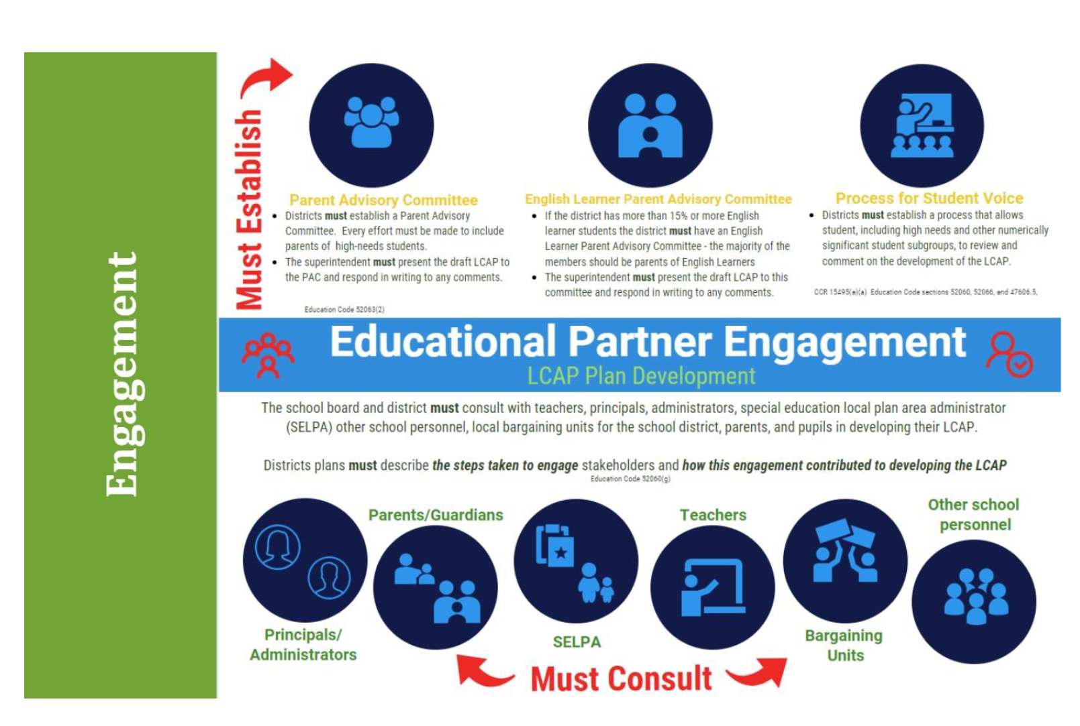
Engaging educational partners
Highlights
PAC established
DELAC established
Student Voice process
Consult with teachers, principals, parents, unions, SELPA, other staff, and pupils

Slide 15
Educational Partners
https://media.carnegie.org/filer_public/f8/78/f8784565-4bd6-4aa3-bd80-2b98fd43380e/parent-engagement-2018.pdf

Slide 16
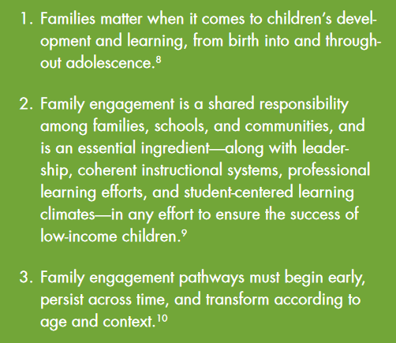
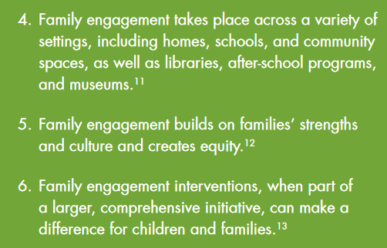
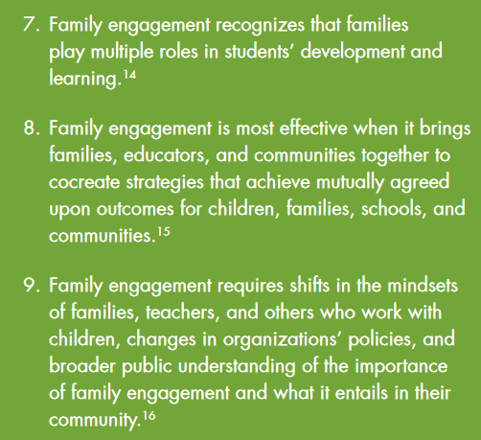
Building family and community engagement
Principles of Research and Practice for
Building Family and Community Engagement
Principles to Ponder: Is there one principle that stands out to you?
When one does…write down the number for the upcoming interactive activity.

Slide 17
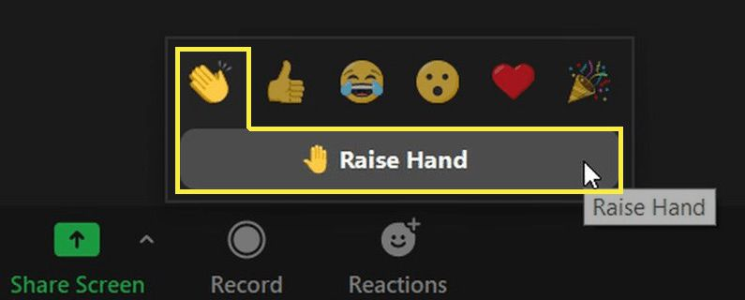
MAD LIB - Modified
Sentence Frame 1:
I chose principle (X) about (summarize the principle), because it makes me feel (insert feeling).
Sentence Frame 2:
I chose principle (Y) about (summarize the principle), because I can see how it will (help/enhance/improve) engagement by (insert how engagement will be enhanced/improved).
Using Zoom’s Reaction Features:
Raise Hand to share out.
Thumbs Up for Like.
Heart for Love
Party Favor for a good job.
Need more time, but still want to include your response, email: lcap@stocktonusd.net

Slide 18
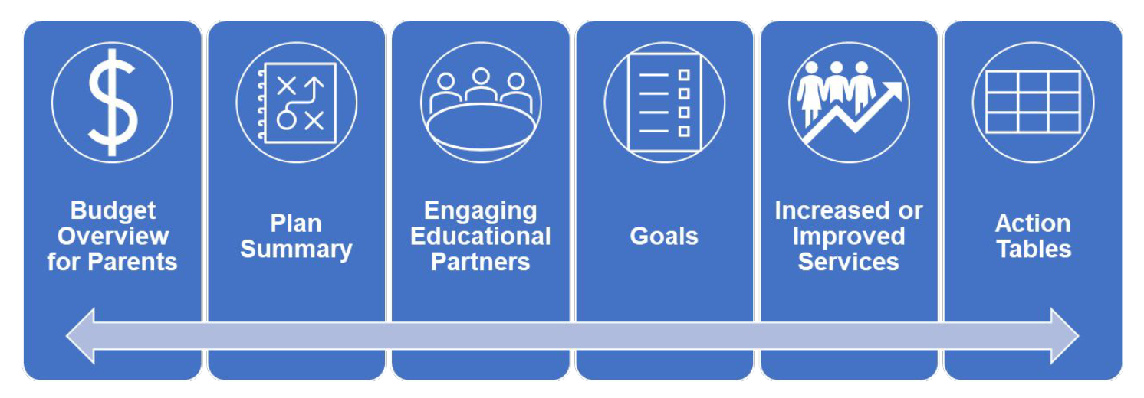
Lcap plan Sections and supporting documents
Supporting Documents
Mid-Year LCAP Update – February 28
LCAP Federal Addendum – June 30

Slide 19
LCAP Federal Addendum

Slide 20
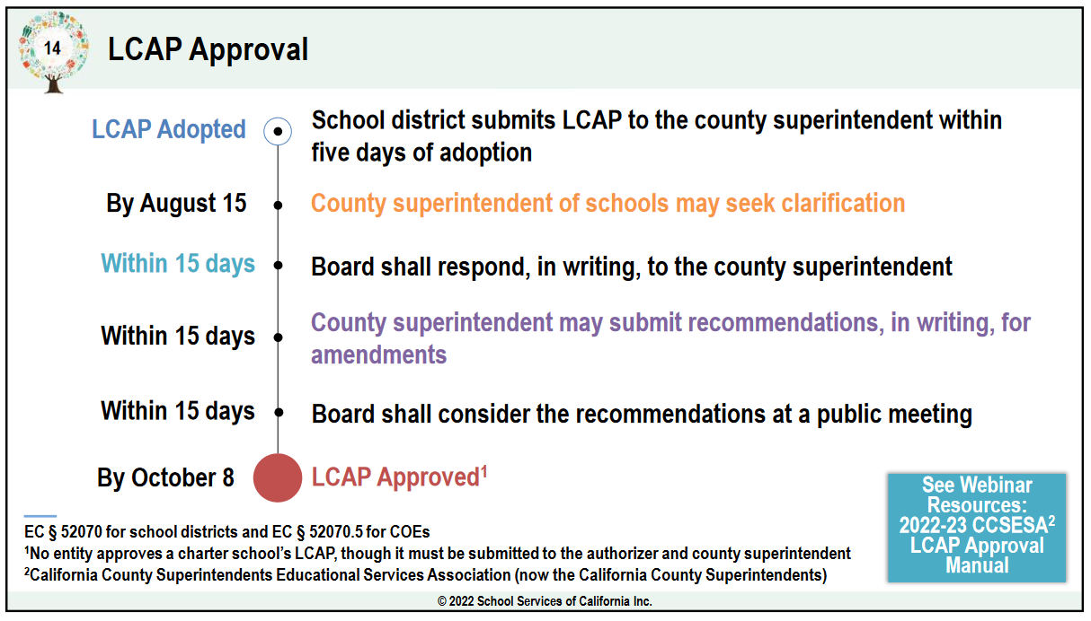
Lcap approval process
2024 Board Meeting Calendar is slated for approval at the December 12, 2023 board meeting.

Slide 21
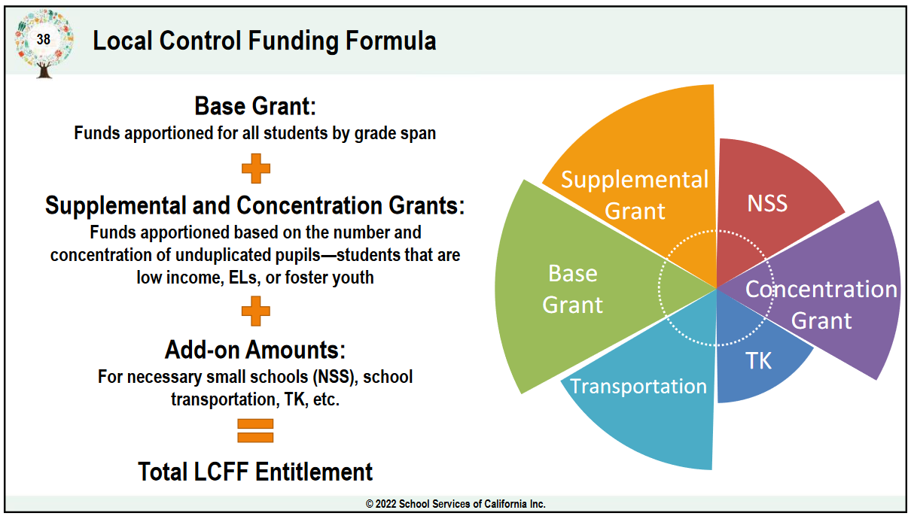
LOCAL Control funding formula (1)
Supplemental Funds equal 20% of the Adjusted Base Grant generated for each student identified as foster youth, English learner or low income
Concentration Funds equal 65% of the Adjusted Base Grant generated when student identified as foster youth, English learner or low income comprise more than 55% or more of the district enrollment, generated for each student above that threshold

Slide 22
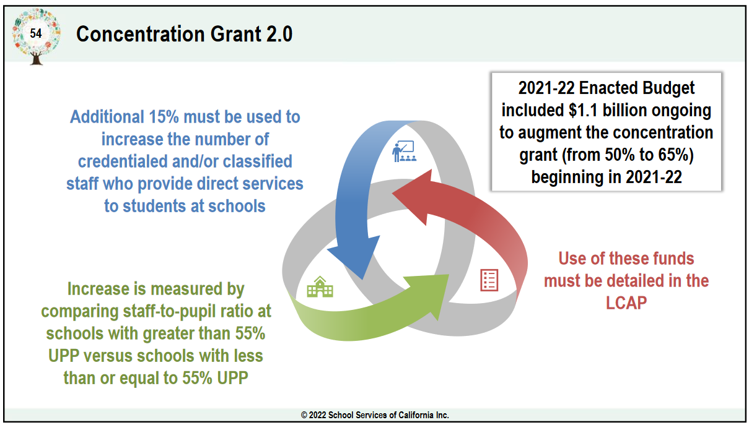
Local control funding formula (2)
Specific Staff Support
Student Support Technicians
Bilingual Assistants
Library Media Assistants
School Psychologist
Custodians
Descriptions of how direct support personnel were identified in located in the 23-24 LCAP on page 218.

Slide 23
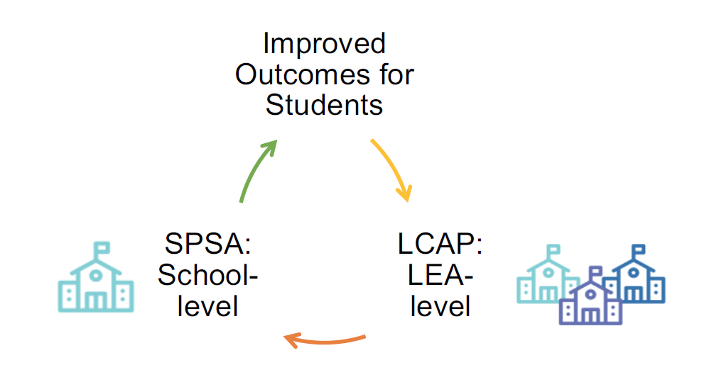
LCAP and SPSA Alignment

Slide 24
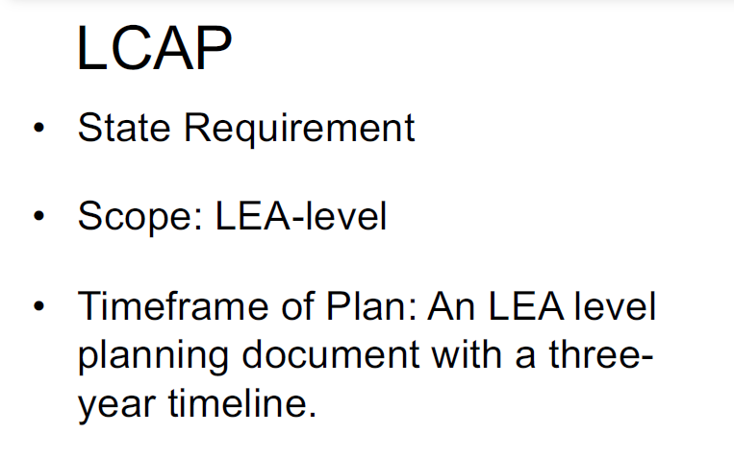
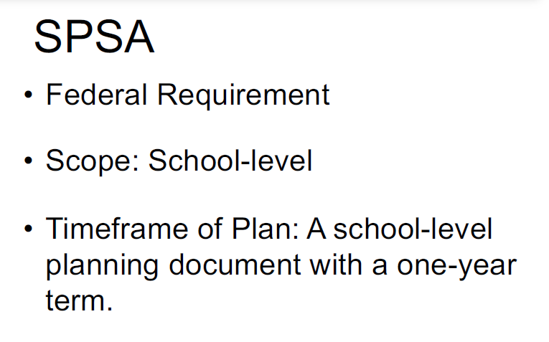
Lcap vs. SPSA
Local Control Accountability Plan
School Plan for Student Achievement
LCAP is available at:
https://www.stocktonusd.net/Page/16289
SPSAs are available at:
https://www.stocktonusd.net/Page/10028

Slide 25
Lcap and SPSA alignment (1)
Local Control Accountability Plan
School Plan for Student Achievement

Slide 26
Lcap and SPSA alignment (2)
Local Control Accountability Plan
School Plan for Student Achievement

Slide 27
Lcap and SPSA alignment (3)
Local Control Accountability Plan
School Plan for Student Achievement

Slide 28
Lcap and SPSA connections

Slide 29
Next lcap engagement session
FOCUSED TOPIC:
Current District Priorities – 2023-2024 SY
DATE:
December 4, 2023
TIME:
9:00 a.m. – 10:30 a.m. – Zoom (https://us06web.zoom.us/j/88016804412)
5:30 p.m. – 7:00 p.m. – In Person @ Merlo Institute

Slide 30
LCAP Engagement in 2023-2024
11/28: Introduction: LCAP Fundamentals
12/04: Current District Priorities – 2023-2024 School Year
01/19: LCAP Mid-Year Update and Funding
02/09: Data Analysis / District Areas of Need
02/19: Budget Projections
03/05: Survey Results and Key Findings
03/08: Identified District Goals/Activities
* April 2024: Post Draft 2024-2027 LCAP
* May 2024: Public Hearing 2024-2027 LCAP
* June 2024: Board Adoption 2024-2027 LCAP

Slide 31
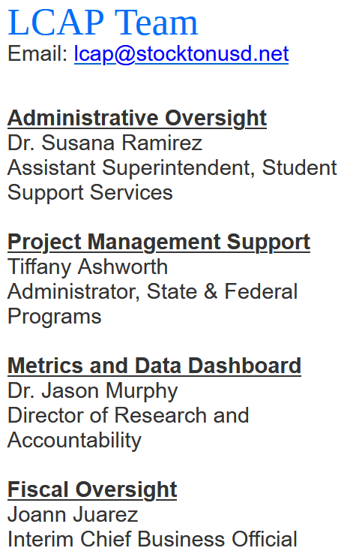
THANK YOU!

